Slide 1
Module 42: Understanding Interactive and Long-Running Flows
Siebel Core Developer and Technology School
Notes:
Time: Lecture: 30 minutes; labs: 55 minutes
Intent: To describe the functionality available through two types of workflows: interactive flows and long-running flows.
Flow: The module first explains the four categories that are used for workflow processes. Next, students learn about the Interactive Process Framework that uses interactive flows to guide user navigation in a work process as defined by the workflow. This section includes steps for configuring synthetic event buttons. Students then learn about the End-to-End Business Process Framework that uses long-running flows to track sub processes within a parent process over time. Included here are steps for assigning a sub process to a user.
Key Terms:
7.0 flow
Service flow
Interactive flow
Long-running flow
Interactive Process Framework
Synthetic events
End-to-End Business Process Framework
Persistence
Please note: Faculty-specific notes are italicized.

Slide 2

Module Objectives
After completing this module you will be able to:
  Differentiate when to use each Workflow process mode for given business scenarios
  Configure synthetic event buttons for an interactive process
  Invoke a long-running flow using the User Event business service
Why you need to know:
  Select the appropriate Workflow mode for Workflow processes you create
  Simplify configuration using provided functionality
Notes:
Each objective and “why you need to know” should be stated aloud.

Slide 3
Workflow Modes
0/4
Workflows are categorized into modes that characterize their runtime behavior
7.0 Flow
Service Flow
Interactive Flow
Long-Running Flow
Notes:
This is a positioning slide; details are presented in the following slides. In Siebel 7.7, Workflows can be categorized in four different modes. This section briefly describes each of these four modes, and the remainder of the module goes into more depth for Interactive and Long-running flows.

Slide 4
7.0 Flow
1/4
Provided for backward compatibility of 7.0 flows
Existing workflows are defaulted as 7.0 flows
  All new workflows should be categorized as something other than 7.0 Flow
Notes:
The 7.0 Flow category is for Workflow processes that were created in versions before Siebel 7.7. Many of the Workflow processes in the Siebel sample database have been set to this category. When customers create any new workflow process, they should use some category other than 7.0 Flow.

Slide 5
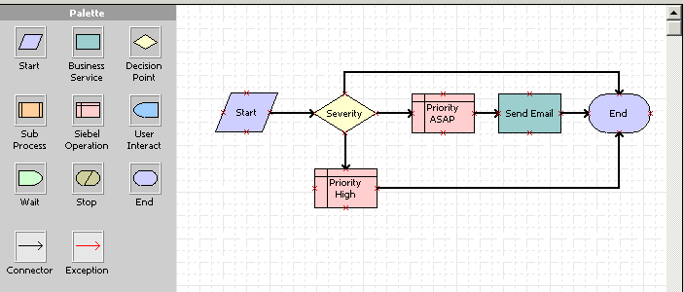
Service Flow
2/4
Simply executes a set of operations upon event invocation
  New Workflow processes default to Service Flow
  Categorizing a Workflow as Service has no relation to Service business object
For example: Check SR priority
Notes:
Service flow is probably the most common category for new Workflow processes. A service flow describes a simple series of steps to execute a concise unit of work. A Workflow process that simply sends an email would be categorized as a service flow. The Workflow process that has been used in the examples in this course, Check SR Priority, is another example of a service flow.

Slide 6


Interactive Flow
3/4
Navigates user across Siebel views
Runs in user session
For example: Navigate to a specific view
User Interact Step
Notes:
An interactive flow contains one or more user interact steps that navigate the user across Siebel views. Because an interactive flow requires user input, it runs in a user session, not in the background. The two Workflow processes displayed here are from the sample database and would likely have the 7.0 Flow category, however, they are examples of navigation sub processes that could be categorized as interactive flows.

Slide 7
Long-Running Flow
4/4
Persistent, long-running flows that last for hours, days, months
No user interact steps involved, can contain Interactive Flows as a sub-process
Examples:
  Approval processes
  Send order to SAP and await response
Notes:
The Long-running Flow category is provided for persistent, complex Workflow processes that, either through sub processes or wait steps, may last for hours, days, or even months. In some cases, a long-running flow may also span many users, each with their own user session. Long-running flows don’t typically contain individual user interact steps, but may have interactive flows as sub processes.
An example of a long-running flow would be one that contains an approval process, so the Workflow will have to pause while it waits for approval from a manager. Another example is in order processing where the Workflow may send order information to an external system, then wait for a response. In both of these examples, the wait time may be just an hour or it may be weeks. The long-running flow category is meant to accommodate these complex flows.

Slide 8
Interactive Process Framework
Business Challenge:
  Companies need to be able to restrict users from free-flow navigation when the navigation is process-based
  Users need the flexibility to pause and resume the flow
    To collect more customer information at a later date and return to the point where they left-off in the process-based navigation
Solution:
  Interactive flows can be used to provide more navigation assistance to end users
Notes:
Interactive flows are part of the Siebel application’s enhanced interactive process framework. Explain interactive process framework as a solution for two basic business challenges. In Siebel 7.7, interactive flows are used to both control user navigation as well as give users the control they need in process-based navigation. The next several slides provide more detail about the interactive process framework and, more specifically, about interactive processes.

Slide 9
Defining Interactive Flows
An interactive workflow process is used to control user navigation between application views
  Primarily made up of User Interact steps
  Generally involves a Runtime Event and User Interact step(s)
  Can run only within the context of a user session
Notes:
With user interact steps, interactive flows can be used to direct navigation when tasks need to be completed in a specific order based on a standardized business process.

Slide 10
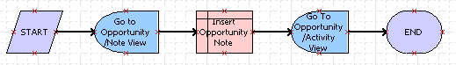
Interactive Flow Example
Interactive flows can be used to direct navigation when tasks are guided by a business process
User is guided to Opportunity/Note view
Note automatically inserted to database
User is guided to Activity view
Notes:
The Workflow process presented on this slide should be included as a sub process in a parent Workflow process. This flow first guides the user to the Opportunity/Note view where they enter a note for the opportunity. In the Siebel Operation step of this flow, that note is automatically inserted in the database. In the last step, the user is guided to the Opportunity Activity View. At the end of this process, the user returns to the parent Workflow process.
Imagine however, that even though these activities are prescribed by a business process, the user may need to suspend the process to get the information needed for the note on the opportunity, or the user might need to bypass this sub process altogether. The enhanced interactive process framework allows this control by the user through a feature called synthetic events (see next slide).

Slide 11
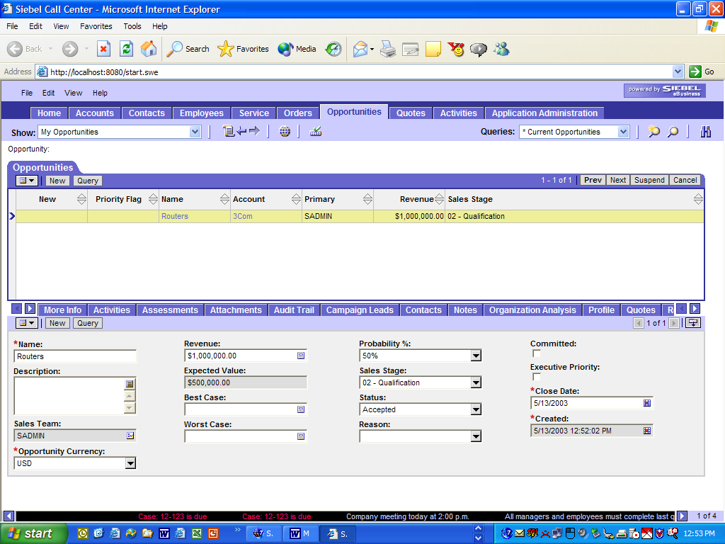
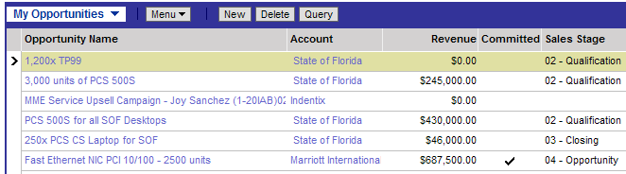
Synthetic Events
Are navigation controls for interactive flows that allow the user to pause in the middle of a process and resume from their Inbox
  Suspend flows by
    Clicking Save button; or
    Navigating out of a structured flow
Synthetic Events to control navigation
Notes:
Users can now suspend an interactive flow in the middle of a process and resume the process from their Inbox. This feature is extremely useful in situations where a transaction cannot be completed because of lack of information. For example, the user might need to navigate to the product catalog to answer a specific customer question. The process can be resumed from the user’s Inbox. Once the interactive process is completed, the Workflow engine will remove the process from the user’s Inbox.
Users can also cancel a process in the middle of processing. Clicking the Next and Previous will take the user to the next and previous views as defined in the workflow process. The Next, Previous, and Cancel buttons are dedicated events that are interpreted by the workflow engine to resume interactive flows.
The User Interact step can also take a process property as an input. This allows for dynamic setting of the view name. The benefit is simpler and more elegant design of interactive flows.

Slide 12
Configuring Synthetic Events
0/3
Synthetic event buttons are NOT visible to users unless they have been configured in Siebel Tools
Create Button
Associate Events to Button
Associate Methods with User Interact Step
Notes:
This is a positioning slide; details are presented in the following slides.
To place synthetic events on any applet used in a process flow, there is some configuration required in Siebel Tools. The following slides provide detail on the required configuration tasks.

Slide 13
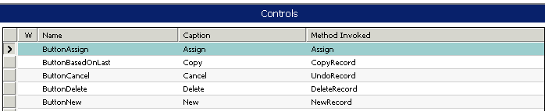
Create Button
1/3
Create button on an applet used in a view contained in a long-running flow
Copy and modify an existing button control to save time and reduce errors
Opportunity Note view uses Opportunity Note applet
Notes:
Continuing the example presented on slide 10, to place a button on the Opportunity/Note view, the developer would first determine the name of the applet, then review the controls for that applet. To create a new minibutton control, copy an existing control and modify the necessary parameters to create a minibutton (see next slide).

Slide 14
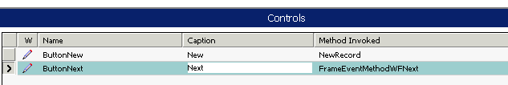
Associate Events with Button
2/3
Method: FrameEventMethodWFxxxx
  Replace 'xxxx' as appropriate
    FrameEventMethodWFNext
    FrameEventMethodWFBack
    SaveWorkflow
    ResumeLastIntFlow
Specify method invoked
Notes:
The Method Invoked property for a synthetic event button should be set to one of the events listed on this slide.
In the lab, FrameEventMethodWFNext and FrameEventMethodWFBack will be used to create Next and Back minibuttons.

Slide 15
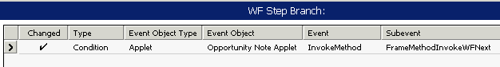
Associate Methods to User Interact Step
3/3
Associate methods to User Interact step branches (outgoing) within the flow
Notes:
In the workflow process itself, a synthetic event is similar to a runtime event. The view to which the user is navigated is specified in the user interact step, and the event that navigates the user there is specified on the outgoing branch for that step. Like a runtime event, the branch type is Condition, but the Event Object Type is Applet. The Event Object specified the applet that has the synthetic event button, with the Event method as InvokeMethod. Finally, the Subevent specified must match the synthetic event defined for the minibutton.
ERRATA: Screenshot shows incorrect Subevent. Should be FrameEventMethodWFNext.

Slide 16
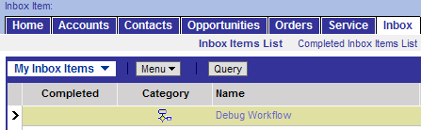
Resuming Interactive Flows
During a user session, saved flows are saved in the Workflow memory cache
  Up to eight saved interactive flows can be cached
Saved flows are listed in the user’s Inbox
  Auto Persist flag must be checked in Siebel Tools for an interactive flow to be saved to the user's Inbox upon log out
Resume from user Inbox
Suspended process
Notes:
Previously, you learned how the Inbox is used for workflow simulation. The Inbox is also used to display suspended workflows. Keep in mind that suspended flows are not only those that the user has manually suspended through the Suspend button, but also any interactive flow that the user has interrupted by navigating to another view, or a flow where the user session has timed out.
By drilling down on a workflow process listed in the Inbox, a user can resume a suspended process. The interactive flows remain in memory, or cached, for the user to resume. With the assumption that it is not common for users to have a large number of unfinished tasks at hand, the upper limit of the Workflow cache size is 8 process flows.

Slide 17
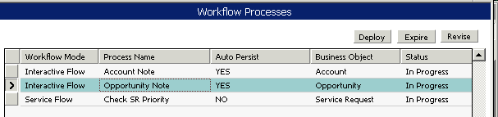
Persistence and Interactive Flows
Persistence allows process resumption
  Set Auto Persist to YES for interactive flows using synthetic events
Attribute of a Process
  Controlled through setting of Auto-Persist flag
    Interactive flows are persisted using Auto-Persist flag
    Long running workflows are automatically persisted
Notes:
Persistence is a workflow process parameter that allows the process to remain in the cache over time. Persistence in this scenario has nothing to do with workflow monitoring as it did in Siebel 7.0. For interactive flows, the Auto Persist parameter should be set to Yes so that if the process is suspended, the data can be saved and restored when the process is resumed. (Note that for long-running flows, persistence is automatically flagged by the server. This makes sense since long-running flows, by definition, must saved over long periods of time.)
For instructor reference, in Siebel versions prior to 7.7, persistence is part of monitoring workflows. In 7.7 monitoring is handled differently and does not require persistence.

Slide 18
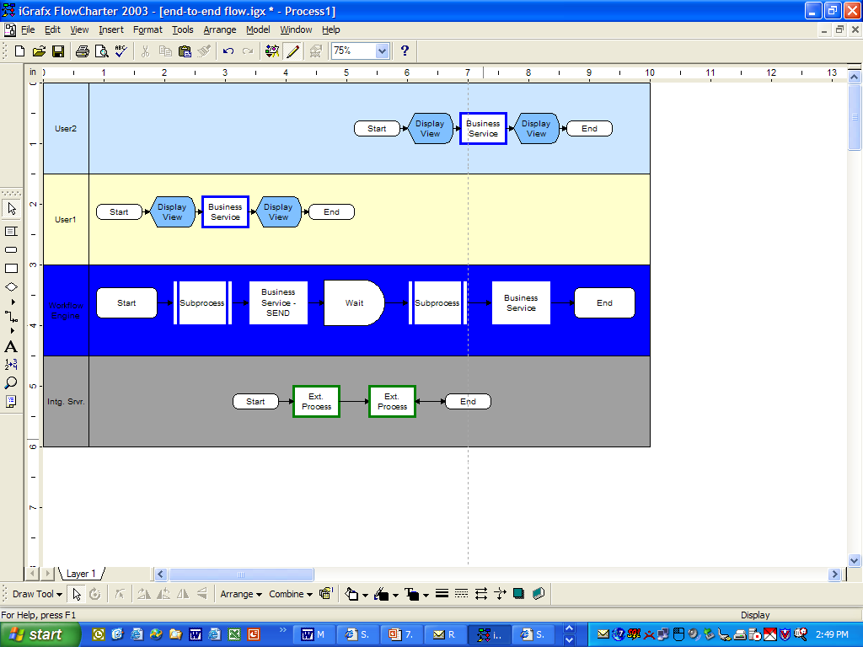
End-to-End Business Process Framework
Business Challenge:
  Assign an entire work process (rather than tasks) to users
  Work processes are sequenced and tracked within a larger, overall process
Solution
  Assign a sub process within a long-running flow to a user
Assign work process to user
Notes:
While interactive flows make up the Enhanced Interactive Process Framework that meets business challenges for business process-based navigation, the Siebel End-to-End Business Process Framework describes how long-running flows are used to meet a different set of challenges.
Companies have a need to be able to assign work process to users at the process level rather than at the task level. While Assignment Manager is the appropriate tool for assigning tasks, it is possible to assign an entire sub process to a specific user. The diagram on this slide depicts a business process flow with a parent business process in the bottom, a sub process assigned to User1 in the middle, and a second sub process assigned to User2 at the top.

Slide 19


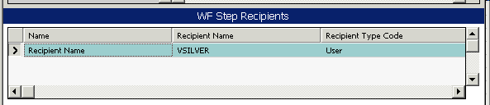
Assigning Sub Processes to Users
Use Step Recipient parameter
Initiating process resumed automatically on completion of sub process
  Integrated with user Inbox
Long-running flows that have sub processes assigned to users are sometimes
referred to as collaborative flows
Right-click sub process step in Siebel Tools
Create recipient record
Notes:
Using the sub process step, developers can assign interactive tasks to end-users. The property, Step Recipient, on a sub process step allows developers to assign a workflow process to an end-user based on login name. This login name may be a literal parameter value, a process property value, or the result of an expression. Users who have a sub process assigned to them will see the process in their Inbox. Once they have completed the sub process steps, the parent long-running flow will resume.
To set this parameter, you can navigate in the OBLE to Workflow Process :: <Process Name> | WF Step :: <Step Name> | WF Step Recipient.
Alternatively, as shown in this slide, you can go to the design canvas, right-click a sub process step, select Show Recipients from the context menu, then add a recipient name in the detail applet.

Slide 20
Invoking Long-Running Flows
Invoke or resume long-running flows from within another Workflow process
  Pass data to be used in a Workflow process
Carry data across the entire flow and all sub processes
  Use a business service step to call the Workflow User Event Service to resume a long-running flow
Send data to be used in another process
Integration Server
Notes:
In this slide, the long-running flow is depicted as a high-level design, not as an actual Workflow process.
Because long-running flows are inherently complex, with sub processes, if not layers of sub processes, and because they last over time and over user sessions, there is a unique challenge in determining when and how to invoke long-running flows. Companies will may need to invoke long-running flows from within another Workflow process, and it may be necessary to pass specific data values between sub processes, or between a workflow that invokes and long-running flow and the long-running flow itself. For example, in this slide, the diagram shows a business service step in the initiating flow passing data to another Workflow process that describes work done by the integration server.
To accommodate these needs, a new business service called the Workflow User Event Service can be used to invoke a long-running flow. This business service can also pass data from the initiating flow to the invoked flow.
The Workflow User Event Business Service is an advanced feature that will not be covered in this course. For more information, refer to the Siebel Business Process Designer Administration Guide in Bookshelf.

Slide 21
Summary
This module showed you how to:
  Differentiate when to use each Workflow process mode for given business scenarios
  Configure synthetic event buttons for an interactive process
  Invoke a long-running flow using the User Event business service
Notes:
Review Question: Which workflow category refers to a simple series of steps to execute a concise unit of work?
Answer: Service Flow
Review Question: What are the three basic steps for implementing synthetic events?
Answer: Create the minibutton control for the applet, associate the synthetic event with the control, associate the method with the user interact step.
Review Question: Do you need to set persistence for interactive flows? For long-running flows?
Answer: Set Auto-Persist to YES for interactive flows. Long-running flows are automatically persisted.
Review Question: For which type of flow would you assign a sub process to a user?
Answer: Assign a sub process to a user (based on login) in a long-running flow.

Slide 22
Lab
In the lab you will:
  Implement an interactive flow for ABC Company
  Configure applets involved in the workflow process to use synthetic event buttons
Notes:
Labs and Troubleshooting:
The lab walks through the steps to create synthetic event buttons. The lab will work properly if the steps are followed exactly the first time. However, because synthetic events are similar to runtime events, if the events are not set up properly and do not fire in the correct order, not only will the lab not function as written, but participants will likely not be able to get the synthetic events to work at all.
The workflow in this lab is provided as a solution (an .xml file they can import).

